Slide 1
Blood Vessels
Vascular diseases are responsible for more morbidity and mortality than any other group of human diseases.
Vascular pathology result in disease via 2 principle mechanisms:

Slide 2
1- Narrowing or complete obstruction---Progressive or sudden
2- Weakening----Dilatation or rupture.

Slide 3
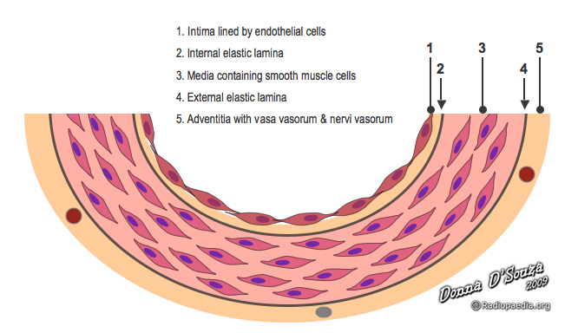
Normal Vessels
- Intima, media, adventitia
- Internal elastic lamina
- Fenestration
- Vasa vasorum
- External elastic lamina

Slide 4
Atherosclerosis (ATH)
Atherosclerosis is characterized by Intimal lesion called atheromas (atheromatous or atherosclerotic plaques), that protrude into the vascular lumina. An atheromatous plaque consists of a raised lesion with a soft, yellow, grumous core of lipid (mainly cholesterol) covered by a firm white fibrous cap. Besides obstructing the blood flow, atherosclerotic plaque weaken the underlying media.

Slide 5
Atheroma, atheromatous or fibrofatty plaque.
Epidemiologic data on ATH are expressed largely in terms of the incidence of the number of deaths caused by ischemic heart disease( IHD).

Slide 6
Atherosclerosis ATH
Symptomatic atherosclerotic disease most often involves the arteries supplying heart, brain, kidneys, and lower extremities. Myocardial infarction (Heart attack), cerebral infarction ( stroke) , aortic aneurysm, and peripheral vascular disease ( gangrene of the legs) are the major consequences of ATH.

Slide 7
Epidemiology
Atherosclerosis is common in developed countries than Central and South America, Africa and Asia.

Slide 8
Risk Factors
Constitutional Risk Factors
Age
Gender
Genetic factors.

Slide 9
Modifiable risk factors
Hyperlipidemia.
Hypertension
Cigarette smoking
Diabetes mellitus.

Slide 10
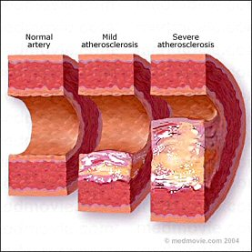
Pathogenesis
The response to injury hypothesis: This hypothesis views the atherosclerosis as chronic inflammatory response of the arterial wall to endothelial injury.

Slide 11
Pathogenesis
1- Chronic endothelial injury with resultant endothelial dysfunction, increased permeability, leukocyte adhesion and thrombosis.

Slide 12
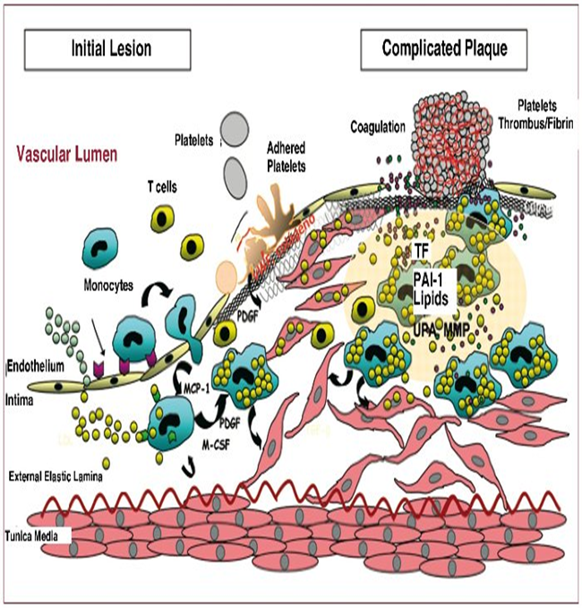

Slide 13
Pathogenesis
2-Accumilation of lipoprotein mainly LDL in the vessel wall.

Slide 14
Pathogenesis
3-Monocyte adhesion to the endothelium followed by migration into the intima and transformation into macrophages and foam cells.

Slide 15
Pathogenesis
4-Platelet adhesion

Slide 16
Pathogenesis
5-Factors released from activated platelets, macrophages and endothelium induces SMCs recruitment from media.

Slide 17
Pathogenesis
6- SMCs proliferation and ECM production.

Slide 18
Pathogenesis
7- Lipid accumulation both extracellularly and within the cells.

Slide 19
Morphology
1- fatty streak: Are composed of lipid-filled foam cells but are not significantly raised and so does not affect the blood flow. They begin as multiple minute yellow flat spots which then coalesce into elongated streaks 1cm long and start to appear in the aorta of infants younger than 1 year.

Slide 20
Morphology
2-Atherosclerotic plaques: Are raised masses protrude into the lumen and vary in size from 0.3 to 1.5cm, appear yellow white or red if thrombosis is superimposed. The most common sites are the lower abdominal aorta, coronary arteries, popliteal arteries, internal carotid arteries and vessels of circle of Willis.

Slide 21
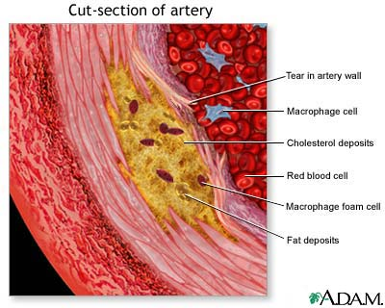

Slide 22
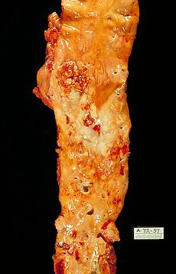

Slide 23
Morphology
Atherosclerotic Plaque
1- Cells including: SMCs, macrophages, and T cells.
2- ECM: including collagen, elastic fibers and proteoglycans.
3- Intracellular and extracellular lipid.
The superficial layer is called fibrous cap and is composed of SMCs and dense collagen. Deep to it is soft necrotic area composed of lipid, debris and foam cells.

Slide 24
Complications
1- Rupture, ulceration or erosion.
2-Hemorrhage.
3- Atheroembolism.
4- Aneurysmal formation

